Slide 1
Intellectual property rights (IPR) protection of multimedia data.

Slide 2
Introduction
Main aim of the project is to provide copyright protection to images over the web. Generally our web site is probably the product of hundreds or thousands of hours of work and an investment of thousands of dollars. Any or all of our original content could easily be copied and displayed to overcome this type of problem copyright protection is needed.
Watermark is a message which is embedded into digital content (images or text) that can be detected or extracted later. Such messages mostly carry copyright information of the content. Watermarking has been revealed to be an efficient technique to cope with the problem of intellectual property rights (IPR) protection of multimedia data. This technology embeds into the data an unperceivable digital code, namely the watermark, carrying information about the copyright status of the work to be protected.

Slide 3
We mainly concentrate on transmission of images safely through watermarking. where the authorized user only can obtain the images without distortion. On the request of user we take the image and watermark image. we send it to the user where watermark can be retrieved and image can be viewed.
To our best Knowledge,upto now there is no research that addresses the issue of web application watermarking. In this paper we propose a new watermarking scheme for web applications.

Slide 4
Proposed Solution :
We mainly concentrate on transmission of images safely through watermarking. Where the authorized user only can obtain the images without distortion. On the request of user we take the image and watermark image. we send it to the user where watermark can be checked and image can be viewed.

Slide 5
SOFTWARE REQUIREMENTS :
Operating System : Windows XP/2003 or Linux
User Interface : HTML, CSS
Client-side Scripting : JavaScript
Programming Language : Java
Web Applications : JDBC, Servlets, JSP
IDE/Workbench : My Eclipse 6.0
Database : Oracle 10g
Server Deployment : Tomcat 6.x
HARDWARE REQUIREMENTS :
Processor : core 2 duo
Hard Disk : 160GB

Slide 6
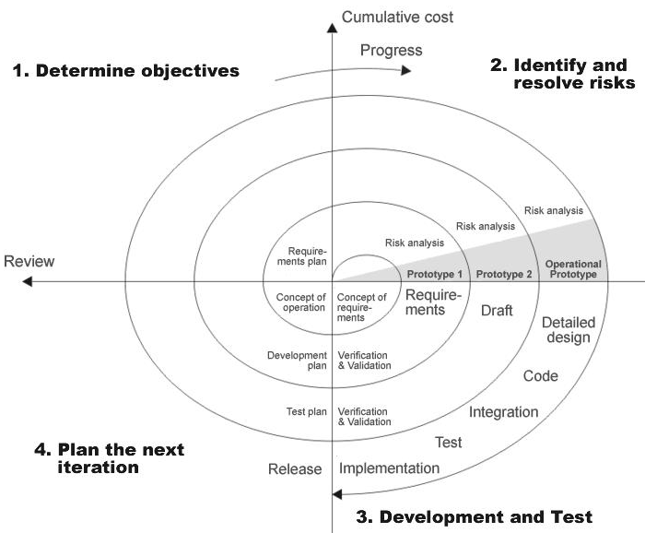
SDLC MODEL

Slide 7
Number of Modules
Type Your Modules Here
For Example
Administration
Users
Watermarking Module
Security & Authentication

Slide 8
Admin Authentication
1. View registered users.
2. Delete registered users.
3. View Requested users.
4. Update status (or) Accept Requested users
5. View Inbox mails
6. View Inbox Water Mark Images.
7. View Outbox mails
8. View outboxes water mark images.

Slide 9
User Authentication
1. Delete, read and download water mark images with private key.
2. Image Water marking with text.
3. Image water marking with another image.
4. Composing mails.
5. Chatting Assistance with reaming users.

Slide 10
Algorithm Explanation

Slide 13
Security Authentication:
Registration
Login
View profile
Update Profiles
Change passwords
logout

Slide 14
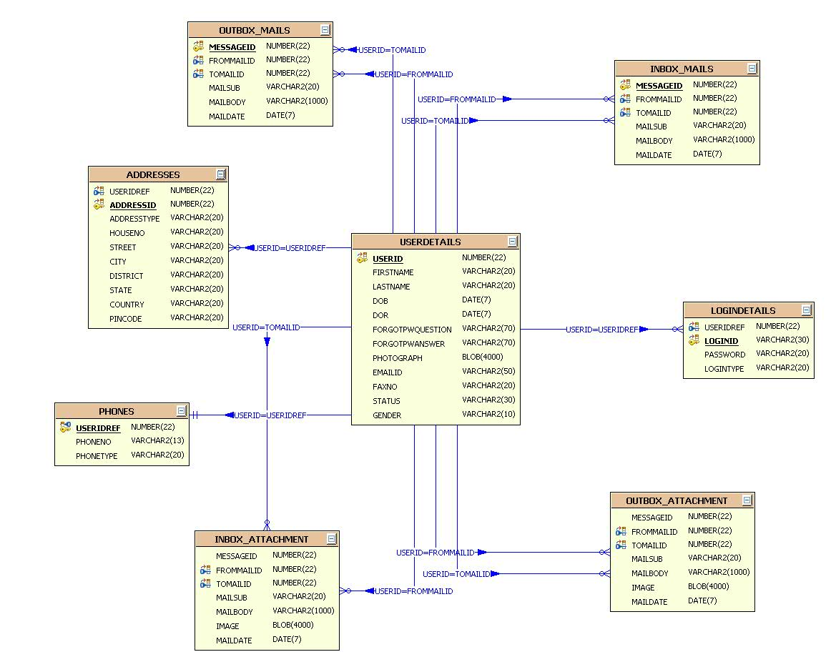
E-R Diagram

Slide 15
Use Case Diagram Admin :

Slide 16
Sequence Diagrams

Slide 17
RegistrationAction
Userdelegate
Userserviceimpl
UserDaoImpl
dbutil
database
1 : Execute()
1 : insertNewUser ()
2 : : insertNewUser ()
3 : : insertNewUser ()
4 : getConnection()
5 : getConnection()
6 : getConnection
7 : exexutequery()
9 : boolean
8 : queryResult
10 : boolean
11 : boolean /failure
UpdateUserProfileAction
Userdelegate
Userserviceimpl
UserDaoImpl
dbutil
database
1 : Execute()
1 : updateUser ()
2 : : updateUser ()
3 : : updateUser ()
4 : getConnection()
5 : getConnection()
6 : getConnection
7 : exexutequery()
9 : returnStatus()
8 : queryResult
10 : returnStatus
11 : Success/failure()

Slide 18
Activity Diagrams :

Slide 19
Conclusion
The Protection of Web Images through Water Marking was successfully designed and is tested for accuracy and quality.
During this project we have accomplished all the objectives and this project meets the needs of the organization. The developed will be used in searching, retrieving and generating information for the concerned requests.
GOALS
Reduced entry work
Easy retrieval of information
Reduced errors due to human intervention
User friendly screens to enter the data
Portable and flexible for further enhancement
Web enabled.
Fast finding of information requested

Slide 20
Future Enhancements
It is not possible to develop a system that makes all the requirements of the user. User requirements keep changing as the system is being used. Some of the future enhancements that can be done to this system are:
As the technology emerges, it is possible to upgrade the system and can be adaptable to desired environment.
Because it is based on object-oriented design, any further changes can be easily adaptable.
Based on the future security issues, security can be improved using emerging technologies.

Slide 21
Bibliography
(1) Java Complete Reference by Herbert Shield
(2) Database Programming with JDBC and Java by George Reese
(3) Java and XML By Brett McLaughlin
(4) Wikipedia URL: http://www.wikipedia.org.
(5) Answers.com, Online Dictionary, Encyclopedia and much more, URL: http://www.answers.com
(6) Google, URL: http://www.google.co.in
(7)Project Management URL: http://www.startwright.com/project.htm

Slide 22
Thank you!

